Slide 1
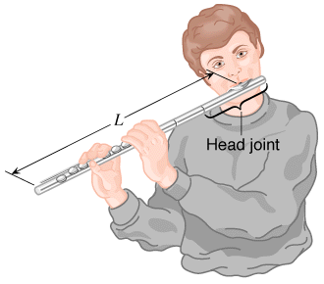
Longitudinal Standing Waves
Musical instruments in the wind family depend on longitudinal standing waves in producing sound.
Since wind instruments (trumpet, flute, clarinet, pipe organ, etc.) are modified tubes or columns of air, it is useful to examine the standing waves that can be set up in such tubes.

Slide 2
Open tube of air
A pictorial representation of longitudinal standing waves on a Slinky (left side) and in a tube of air (right side) that is open at both ends (A, antinode; N, node).
https://www.youtube.com/watch?v=d7W2niNqHWg

Slide 3
Pipe Organ
https://www.youtube.com/watch?v=uRqR9-akXEo
The range of human hearing is roughly from twenty hertz to twenty kilohertz. Based on these limits and a value of 343 m/s for the speed of sound, what are the lengths of the longest and shortest pipes (open at both ends and producing sound at their fundamental frequencies) that you expect to find in a pipe organ?

Slide 4
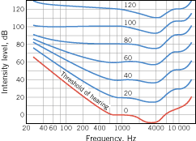
Fundamental Frequency of the Human Ear canal
Sound enters the ear, travels through the auditory canal, and reaches the eardrum. The auditory canal is approximately a tube open at only one end. The other end is closed by the eardrum. A typical length for the auditory canal in an adult is about 3.0 cm. The speed of sound is 343 m/s. What is the fundamental frequency of the canal?

